Slide 1
OK-FLOURISH PITCH DECK
Business Presentation
Notes:
Insert Your Picture>right click>send to back

Slide 2
D
Ok Flourish
Built on OK-Chain
Notes:
Insert Your Picture>right click>send to back

Slide 3

A Little Background
Many Countries around the are now experiencing more hardship due to the pandemic and governments are becoming more totalitarian restricting people from accessing opportunities provided by blockchain technology which has lifted millions of people from poverty mostly in developed countries. To make matters worse, the blockchain solutions available today only favored people in developed nations and other third world participants of the economy are neglected.
OK Flourish is born out of the need to represent marginalized communities of the blockchain revolution era around the world equally, and to provide equal opportunities for all humans wherever they my live around the globe.

Slide 4
01. Stablecoin
To become the no 1 decentralized Stablecoin protocol globally.
02. Equal Representation
To Provide Equal Representation for lower economies in the Stablecoin market
OUR VISION
03. Passive Income
Enrich our users trough the use of perpetual vaults and yield programs
04. Freedom
To be a smooth bridge between traditional finance and Decentralized finance where users can become their own bank.

Slide 5
BANK COMPETITION
Banks don’t support cryptocurrency transactions serving as a barrier to entry for many countries
VALUE LOSS ON SAVINGS
0% interest and decline in value of Fiat savings
The Problems
We Solve.
NO EQUAL REPRESENTATION
No equal representation for other Nation’s Fiat except for US Dollar
LIMITED OPPORTUNITIES
Opportunities of blockchain has mostly only favoured people in developed nations

Slide 6
What opportunities are we enabling?
Enables Cashless but rich economy
Retail Business can now accept Stablecoins
You can save your money in foreign currency

Slide 7








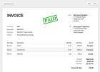








The Use Cases of OK Flourish
OK Flourish stablecoins at the core to empower the unbanked population
OK Flourish removes government bureaucracy making you your own bank
Transfer without censor, make interest on savings, save in foreign currency.
U s e Cases
OKF
Gift cards
Inventory
software
MPOS & POS
Money transfers
OK Flourish
others
savings
E-commerce
credits

Slide 8
WHAT IS OK-FLOURISH?
Why choose OK-Chain ?
OK-Flourish is a Stablecoin protocol that is designed to represent all fiat currencies of lower economies in blockchain space
OKF is the ticker for OK-Flourish protocol token which is built on OK-Chain
OKF will be built on OK-Chain which is cheap, fast and scalable.
We choose OK-Chain because it is fast, cheap and EVM Compatible.

Slide 9
Retrieve your collateral anytime by
returning your stablecoins to the
protocol or selling them.
Repeat the process as much as you like
Become LP to earn transaction fees or
Borrow money with lowest interest
Rate.
HOW IT WORKS
People like you and me who powers OK Flourish Protocol ecosystem
Deposit USDT or OKF into the vault to
print any local currency of your choice
Flourish
Protocol
125% for USDT and 200% and above for OKF
The Vault prints you any desired local currency
Save Your stablecoins and earn high APY on them
Banks will not give you that

Slide 10
REVENUE MODEL
Conversion Fees
Revenue is guaranteed from our vault by charging a small fees for minting stablecoins and vice versa
Yield Rewards
We will connect Locked collaterals to various yield programs which will guarantee consistent returns to LPs and Savers.
How we ensure OK -Flourish Remain Sustainable

Slide 11
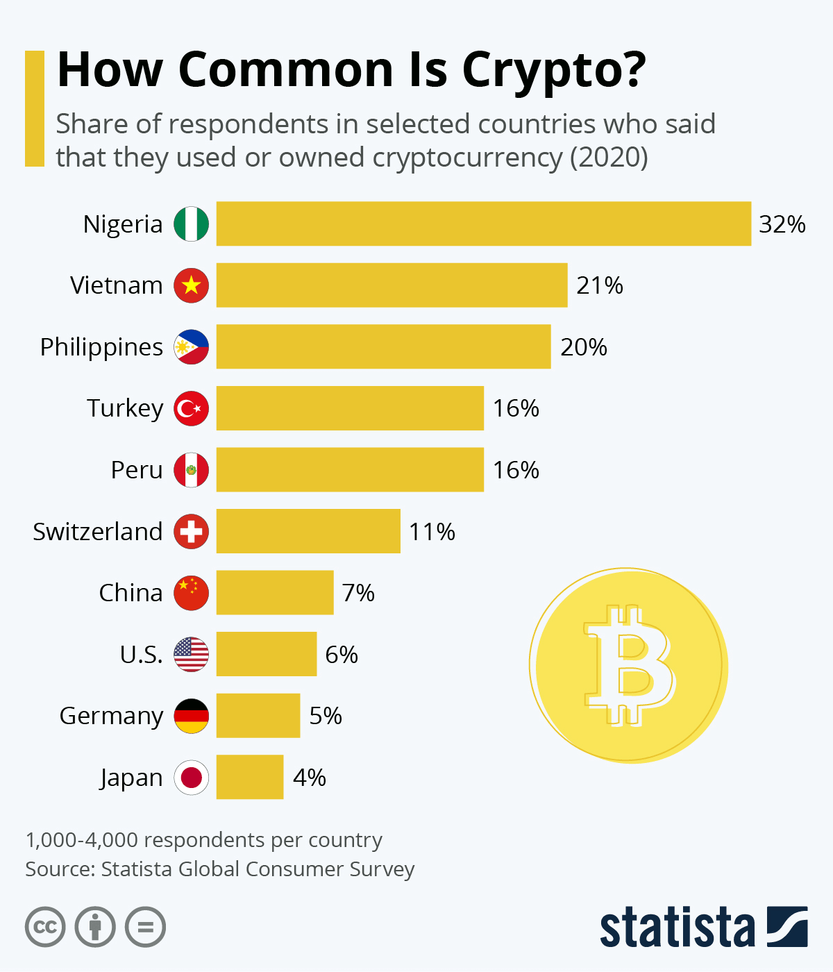
How large is our target market in developing nations?

Slide 12
OKF TOKENOMICS
DISTRIBUTION | AMOUNT | VESTING PERIOD
Maximum Supply | 100,000,000 | -------------------
IIEO | 50% | 10% monthly
Staking reward | 25% | N/A
company reserve | 10% | 1YEAR
marketing & Airdrop | 5% | N/A
Team | 7% | 1YEAR
Advisors | 3% | 1YEAR

Slide 13
SALE ROUNDS
Rounds | Amount | Vesting Period | Price
Seed | 25,000,000 | 20% monthly | $0.1
Presale | 15,000,000 | 12% monthly | $0.2
Public sale | 10,000,000 | 10% monthly | $0.3

Slide 14
SEED FUNDING USAGE

Slide 15
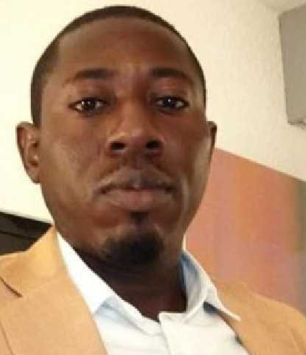
OLADIMEJI SHEKONI
CEO - FOUNDER
Oladimeji Shekoni is a blockchain expert who has worked with various reputable blockchain companies in various capacities especially on the business development side since the past 8 years. Some include Humaniq, Bitcloud, and of recent FIO Protocol and SyncDao
Perspective
80%
Efficiency
85%
Teamwork
85%

Slide 16
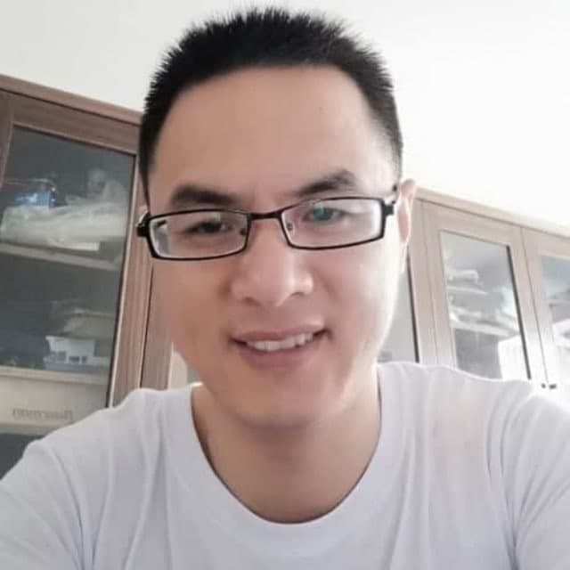
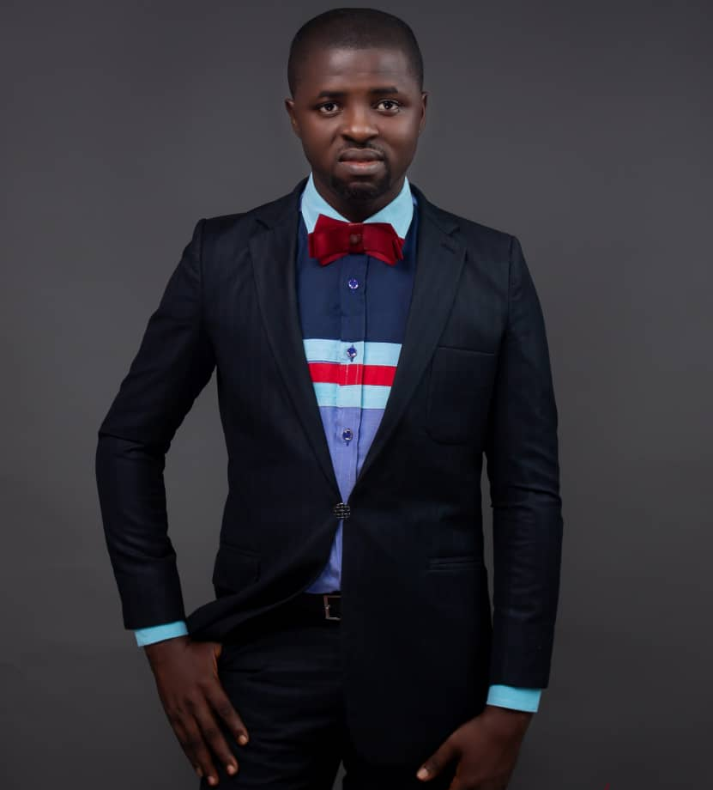
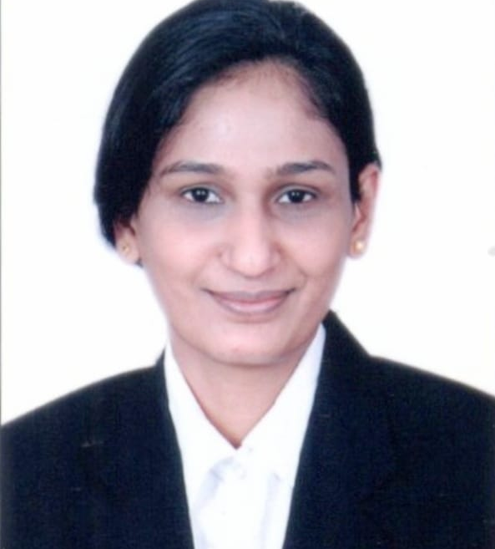
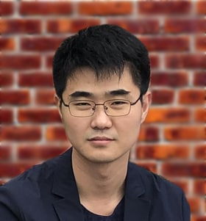
MEET OUR TEAM
John Lee
Stephen Ajose
Hedge pooja
Kabuto Yakoshi
Senior Bloctchain Developer
Chief Operating Officer
Marketing Manager
Chief technical Officer
Our Team is a decentralized team across Africa and Asia. They are people of distinguished personalities and experts in their various positions.

